Slide 1
ENGR 12
Dr. Mandala
Notes:
Down

Slide 2
First year conference
Important to meet with your conference chair and co-chair.
They provide a portion of your grade.
Peer review
Each of you will receive 1 paper from your peers to review and provide feedback.
Provide feedback that is constructive and helps improve the paper.
This is the process followed by Scientific Publications.
Peer review process
You will receive a paper number (thru CW) and link to download the paper.
If paper is blank—it was not submitted yet. Wait.
Download, verify, and print the paper—review with a red/green pen. Print one-sided.
Submit printed reviews in class on Tuesday after Spring Break to receive a full credit. Delay’s will result in reduction of score up to 50%.

Slide 3
Test’s next week
Quiz, Tuesday, Feb 27, in class.
Sample Computer Test.
Team-based.
If time permits, I will review material.
Written Test, Tuesday, Feb 27, at 7PM in Lawrence Hall.
All material covered in class (written quizzes).
At a level where you can solve on paper.
Computer Test, Thursday, March 1, assigned seating.
Large focus on data handling, variables, loops, curve fitting, and plots.
Figuring out how to handle rows and columns
Use of MATLAB functions.
Ability to display and read images.

Slide 4
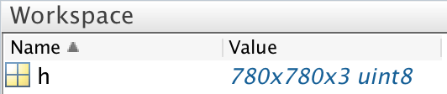
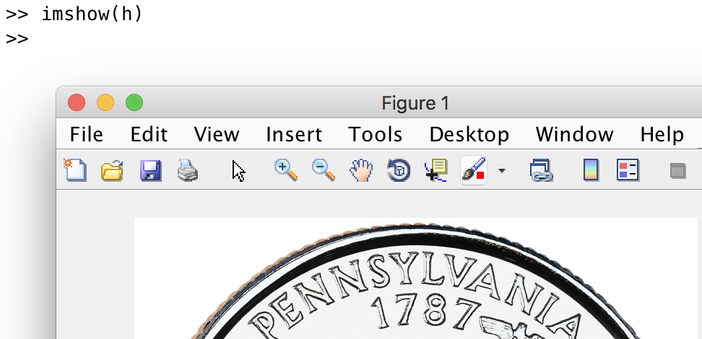
Working with images
Use imread to read image data from current working directory (or any directory if filename contains absolute pathname).
Use imshow to display image stored in MATLAB workspace variable.

Slide 5
Working with images
Images are stored as matrices, typically a 3-dimensional matrix.
Size equals the pixel width and height. With the 3 dimension containing individual color intensity (R-G-B).
100p by 100p JPEG would be stored in a matrix of size 100x100x3
Manipulate the image by changing the values of the matrix.
You can flip, reverse, add, subtract etc.

Slide 6
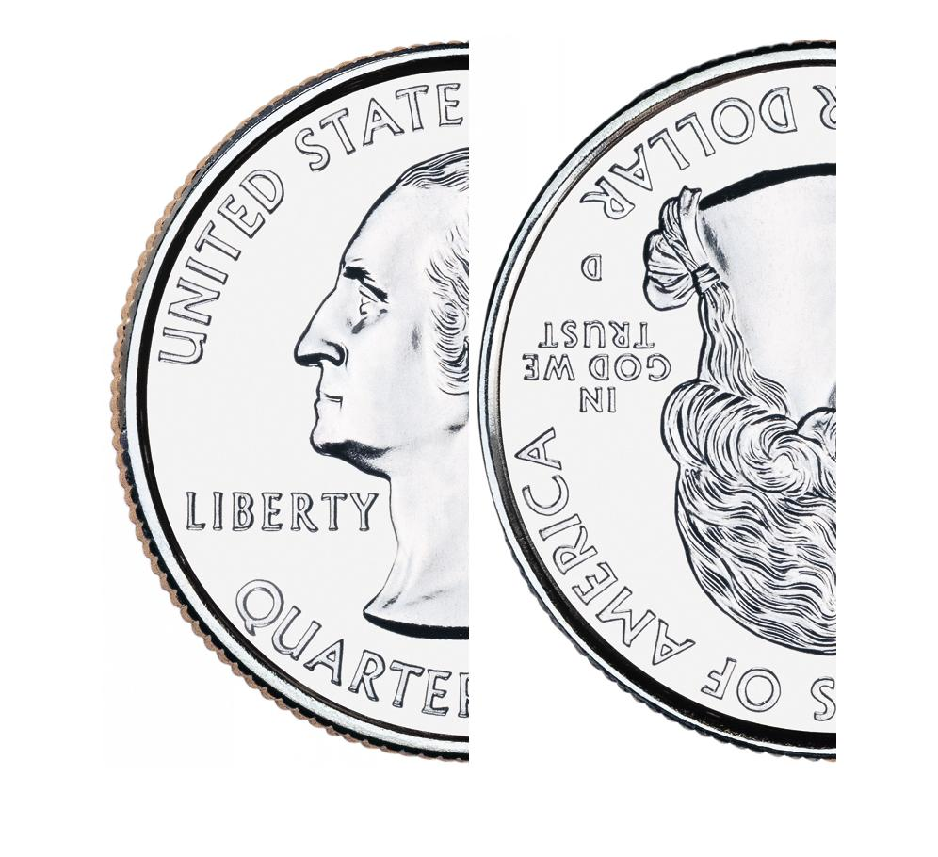
Image Manipulation
To manipulate an image, you need to manipulate its matrix.
In your teams, replicate the image listed below:
https://www.usmint.gov/wordpress/wp-content/uploads/2017/01/2017-america-the-beautiful-quarters-coin-proof-obverse-768x768.jpg

Slide 7
Random Number Generator
rand([size_of_array])
Generate random numbers from uniform distribution (between 0 and 1)
randn([size_of_array])
Generate random numbers from normal distribution (mean 0 and variance 1).
randi([RANGE, size_of_array])
Generate pseudo-random INTEGERS from distribution RANGE
If RANGE=100; randi generates integers from 1:100
If RANGE=[1 10]; randi generates integers from 1:10
To avoid repeated numbers, use randperm
randperm(IMAX)
Generate random permutations of integers in range 1:IMAX

Slide 8
RNG -- MATLAB’s Random N Gen
rng(‘default’)
Resets the RNG Seed to MATLAB start up seed value(i.e., reset the RNG to original state, all random numbers generated after the reset resemble the ones generated at start of MATLAB).
rng(‘shuffle’)
Seeds RNG based on time.

Slide 9
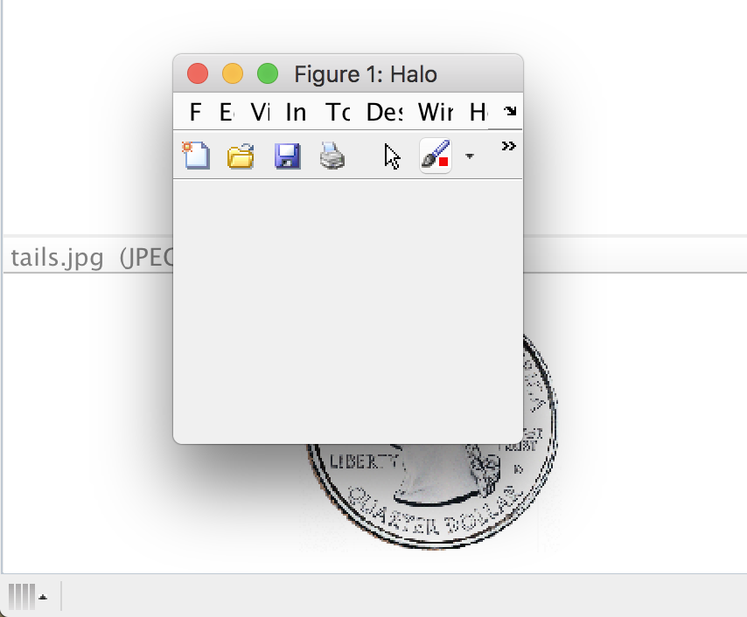
Figure properties
figure(‘Name’, ‘[NAME VALUE]’, ‘Position’, [left bottom w h])
‘Name’: Property of figure that adds a title/name to figure window.
‘Position’: Determines where the figure window is shown on screen along with its width and height (all values in pixels).

Slide 10
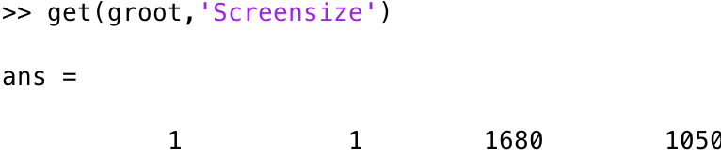
Get command
get(object_handle, property_name) returns the named property of graphic object.
get(f,’color’);
If object_handle is set to 0 or groot, get pulls in values of factory/computer settings
get(groot,’Screensize’) would result in an array containing screen size.

Slide 11



Figure Handle
Create a handle
Invoke figure window by handle
Close specific figure by handle
Close all figure windows

